Slide 1
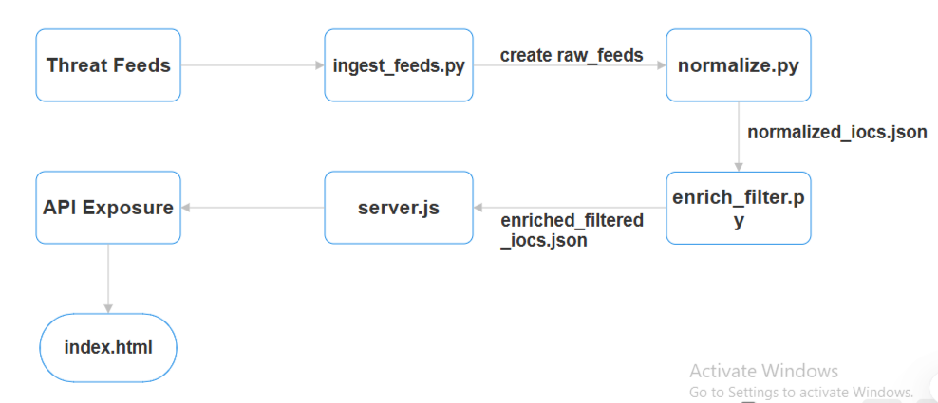
Architecture

Slide 2
Technologies
Python (Data Processing)
Node.js + Express (API Layer)
JSON (Storage)

Slide 3
How to Run
Install Python Dependencies pip install -r requirements.txt
Run the Pipeline (initial load) python trigger_refresh.py
Start API Server cd api npm install node server.js

Slide 4
API Endpoints (Express.js)
Method | Endpoint | Description
GET | /iocs | Give all iocs
GET | /iocs?type=ip | Filter by type ip/url
GET | /iocs?source=xyz | Filter by source(blocklist,spamhaus)
POST | /refresh | Refersh and trigger

Slide 5
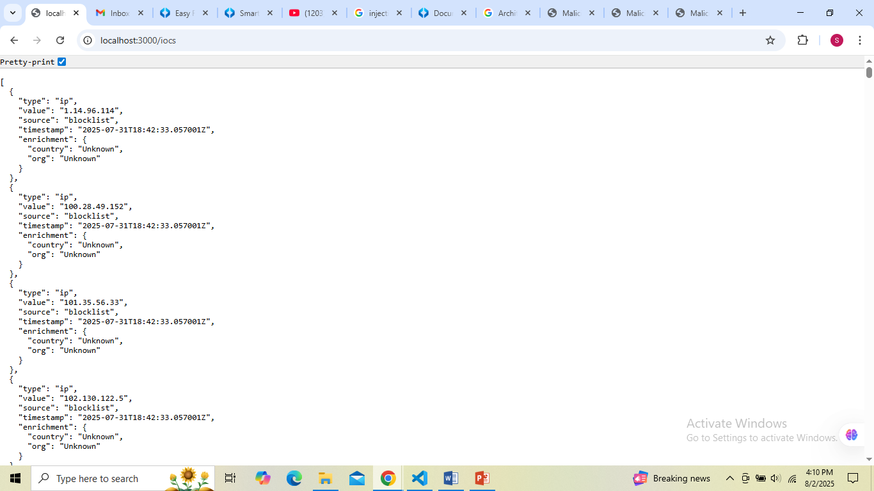

Slide 6


Slide 7
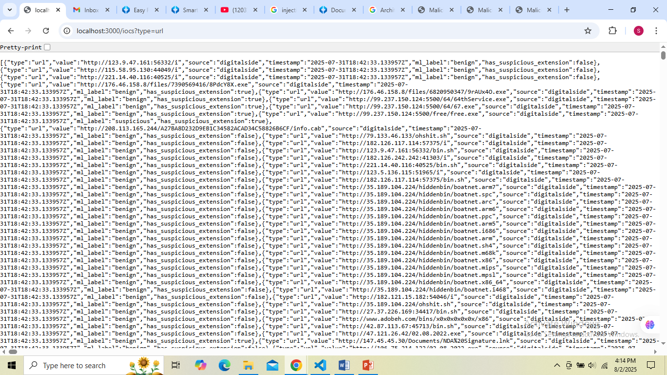

Slide 8
Connect Backend With Frontend

Slide 9
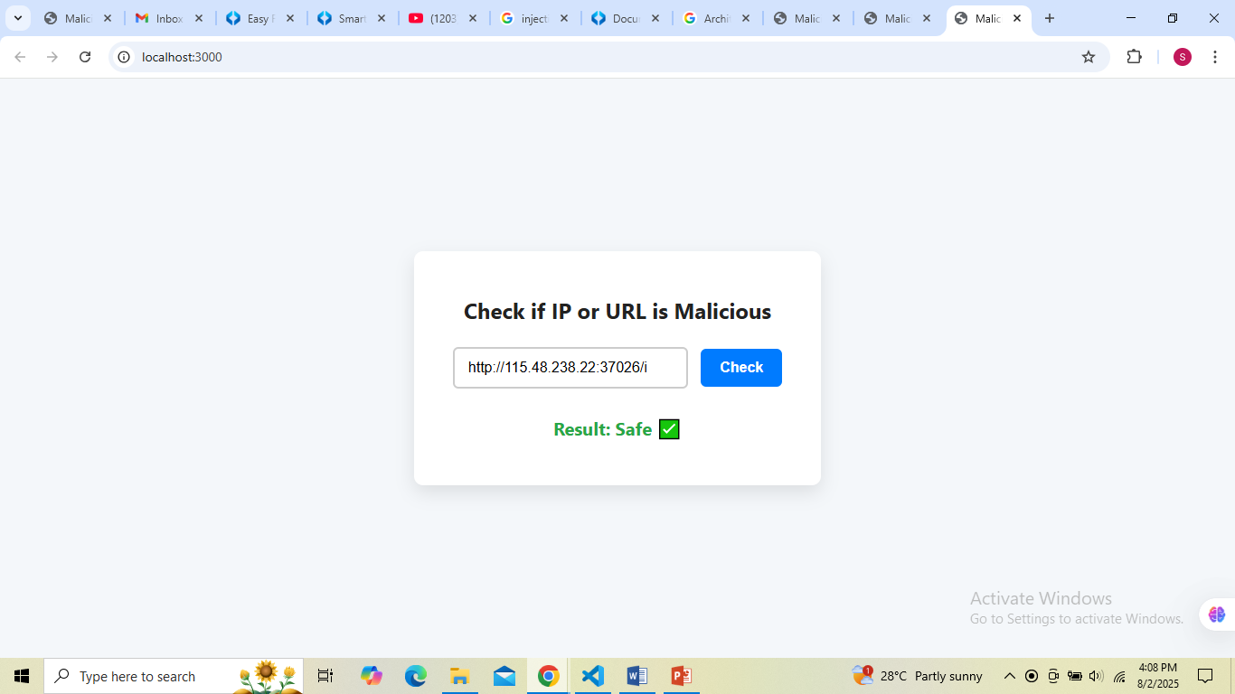
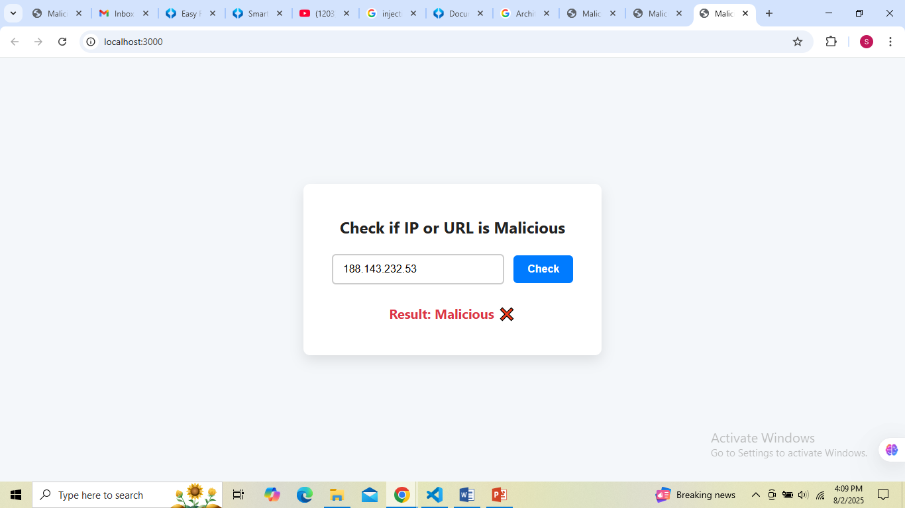

Slide 10
